Slide 1

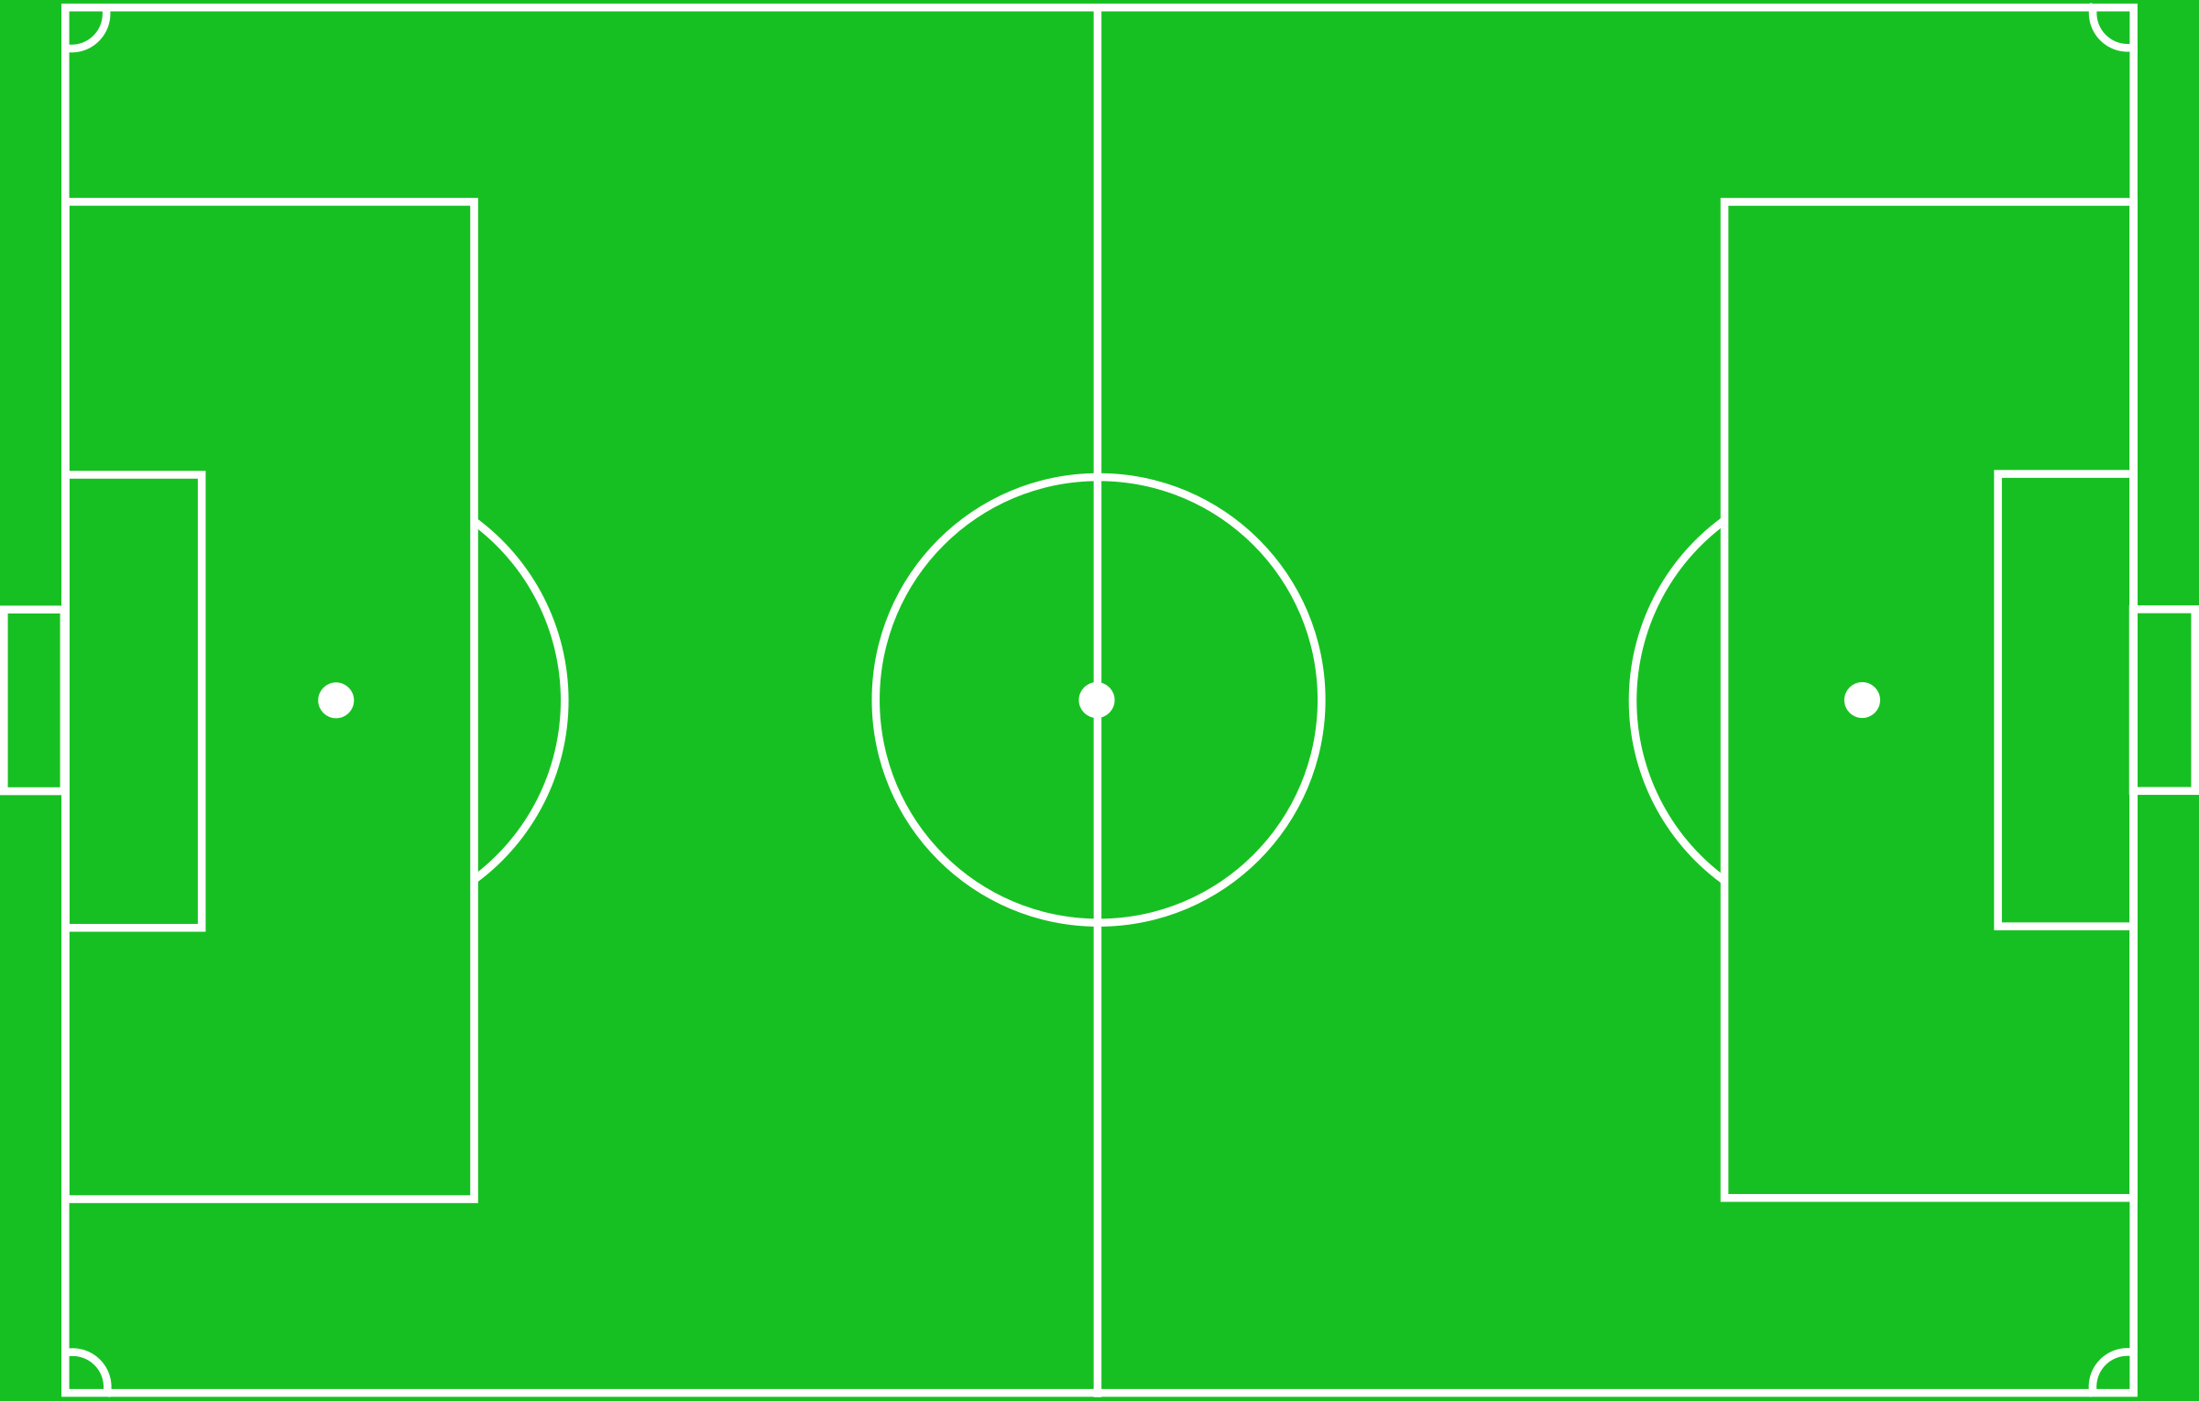
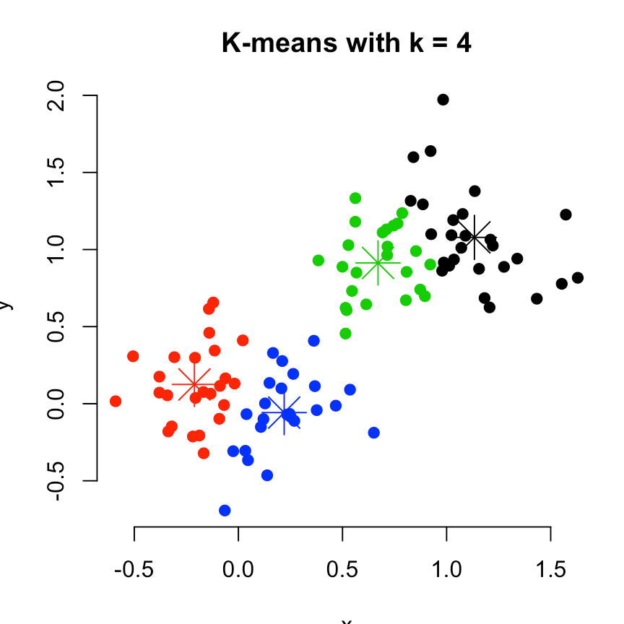
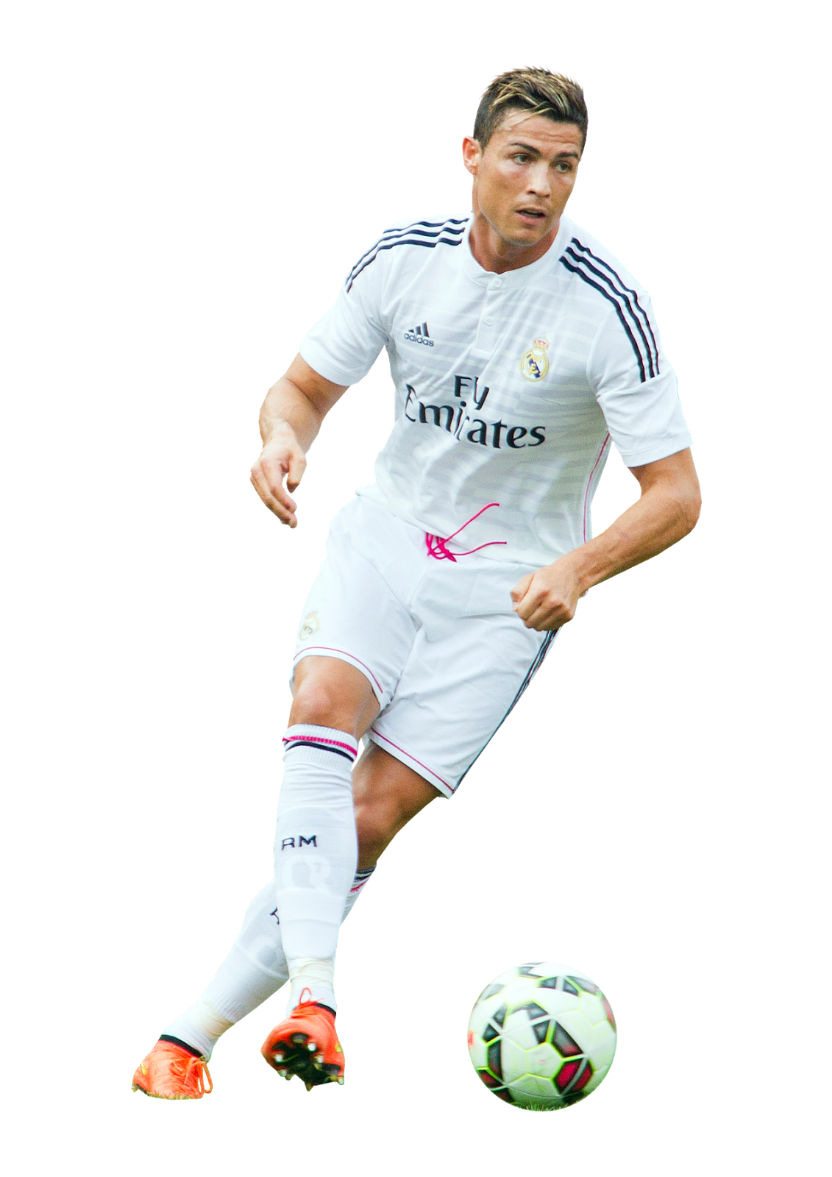
A STUDY OF UNSUPERVISED LEARNING
ON KAGGLE’s FIFA 20 DATASET
SANKIRNA JOSHI

Slide 2
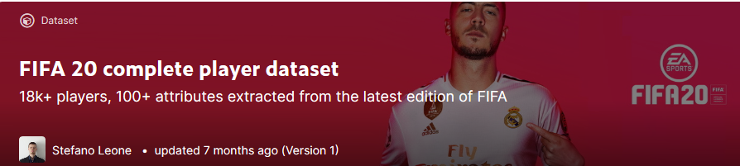
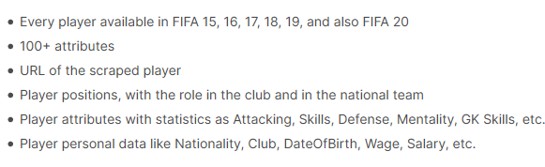
Dataset
1
Dataset is available on Kaggle
2
Contents
SANKIRNA JOSHI

Slide 3
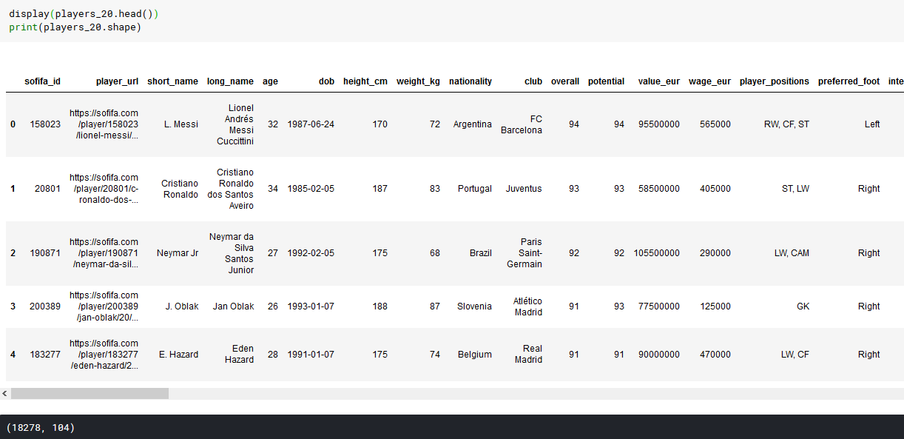
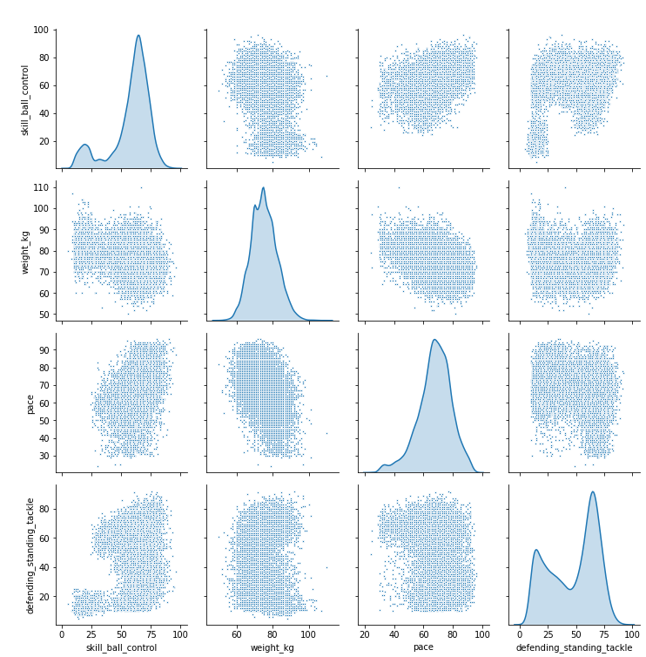
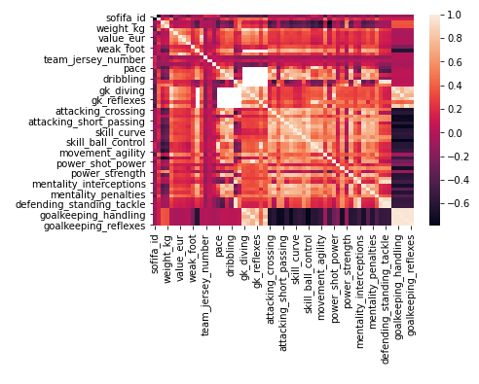
Slide 3
DATA EXPLORATION
SANKIRNA JOSHI

Slide 4

Goals of the project
Detect patterns in the data
Look for feature importance and relevance
Dimensionality Reduction
Principal Component Analysis
Develop clusters and evaluate their performance
Recommend the best players from each cluster based on their strengths and value
SANKIRNA JOSHI

Slide 5

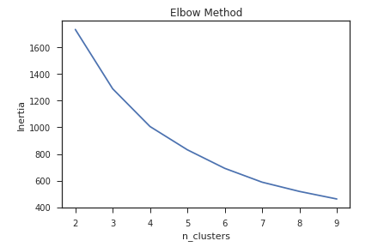
Evaluation Metrics
Silhouette Score and Elbow Method
Model will be evaluated based on the silhouette coefficient which looks for the goodness of the clusters and vetted with the elbow method
A higher Silhouette Coefficient score relates to a model with better defined clusters.
The Silhouette Coefficient is defined for each sample and is composed of two scores: a: The mean distance between a sample and all other points in the same class. b: The mean distance between a sample and all other points in the next nearest cluster.
Elbow is an empirical metric and the ideal number of clusters occur at the elbow of the curve
SANKIRNA JOSHI
Notes:
Now, that you have narrowed your topic, you will want to organize your research in a structure that works. There are some common organizational patterns based on the kind of research you are doing.
Organizational Structures:
Cause and Effect- this kind of structure is great for explaining the causes and effects of a topic
Compare and Contrast- in this pattern you highlight the similarities and differences of the topic
Explain process- this structure is great for outlining a series of steps to follow;
Definition- if you want to make sure your audience understands what something is using illustrations, meanings, clarifying misconceptions, you may want to use this structure
Classification- a common organizational structure is grouping like topics or facts from the research together. For instance, in the internet safety about social media apps, you may organize the research where you look at each social media app one at a time

Slide 6
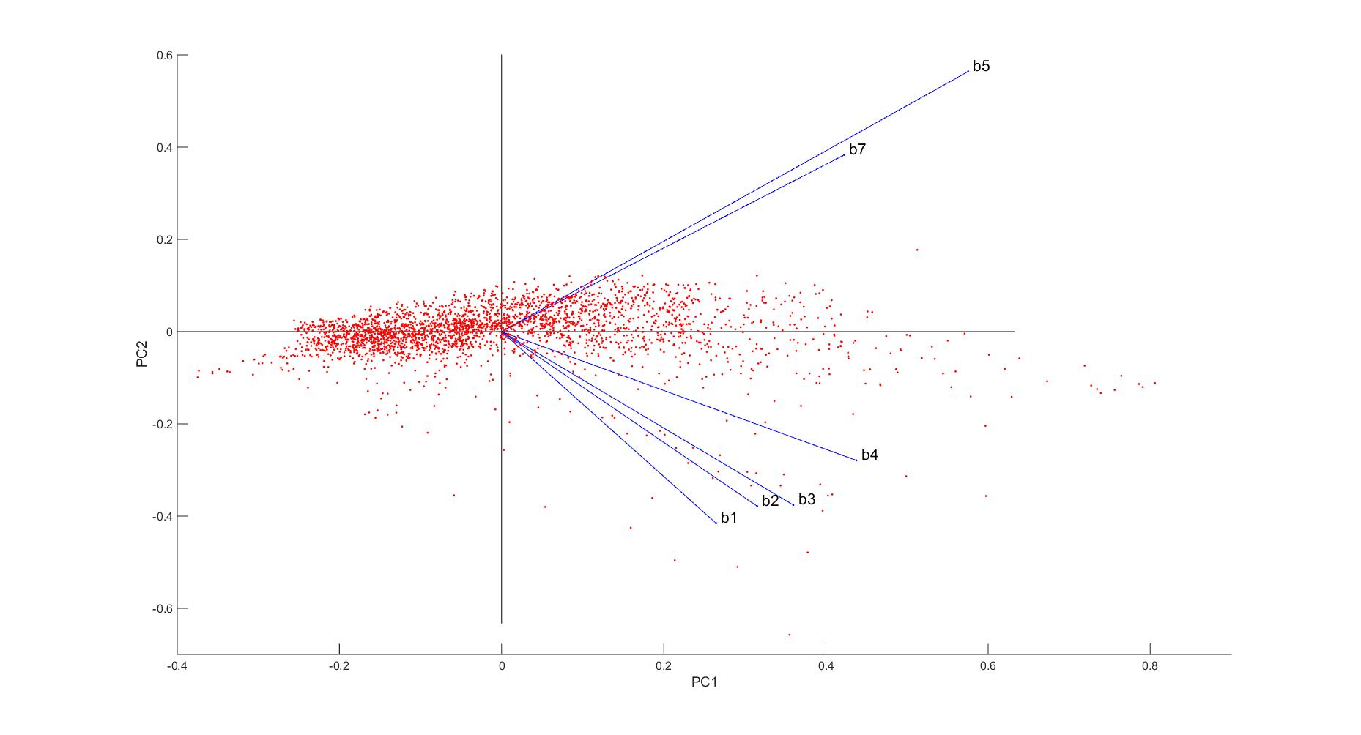
Project Outline
Data Exploration
Feature Relevance
Feature Scaling
Outlier Detection
Feature Transformation with PCA
Clustering Models
Gaussian Mixture Models
KMeans Clustering
Cluster Visualization with Biplots
Data Recovery
Conclusions and findings
Recommendations
SANKIRNA JOSHI

Slide 7

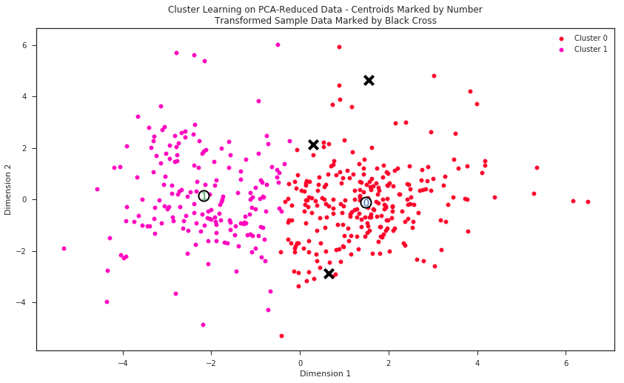
Results
Results can be visualized through cluster plots on the reduced PCA axes.
The original features can be projected onto the clusters through a biplot and can help us identify what correlated features and feature importance
We can summarize and report the best objects of the clusters
SANKIRNA JOSHI
Notes:
After you’ve done your research, it’s time to put your presentation together. The first step in the process is to introduce the topic. This is a great time to connect your topic to something that your audience can relate. In other words, why should they listen to all the information you will be sharing in your research presentation? What is in it for them? You may also want to include a graphic or image to grab their attention.
Feel free to duplicate this slide by right-clicking on this slide in the slides pane to the left and select Duplicate Slide.
The next step in your presentation is to state your claim or topic clearly. Your teacher may even call this your thesis. As you state your thesis, you may find that this layout is not the best layout for your claim or topic. You can change the layout by clicking the drop-down menu next to the Layout in the Slides menu section. You can choose Two Content, Comparison, or Picture with Caption. Note: A different layout might change the look of the icons on this page.
You will also want to state your facts. You have done the research now share some of the interesting facts with your audience. Facts do not have to be boring; you can communicate facts in a variety of ways by going to the Insert Tab. In the Insert tab you can:
Insert pictures from your computer or online.
Add a chart
Create some SmartArt
Insert a variety of icons to help your facts come to life. Note: You can change the color of the icons by selecting the icon and then click on the Format tab and then Graphics Fill. From there, you will choose a color from the list or choose More Fill Colors to give you more options.
Since this research presentation is a result of your hard work and searching, you want to make sure you support the claims or points in your presentation with facts from your research findings. Make sure you give the author proper credit for helping you share your ideas. If one of your sources has a video that is relevant to your topic, you can add the video as added support. Keep in mind the length of the video and the amount of time you have for your presentation. For a 5 minute speech, the video should be no longer than 30 seconds.
Questions to consider:
How will you state the author of the source?
Will you need to cite the source on the slide?
What are some ways you can engage your audience so they feel like they are a part of the presentation? Some ideas to consider is by taking a quick poll like: by a show of hands, how many of you think school uniforms are a way to cut down on bullying? Another suggestion is to have them hold up a certain number of fingers to see if they agree or disagree. Finally, you can share a story that the audience can relate to that makes them laugh.
After all the applause, your audience may have some questions. Be prepared to answer some of their questions by making a list of questions you think they might ask. You may also want to share the presentation with them by providing the link to your presentation, if they want more information.

